Slide 1
Hands on with Time Series Analysis
Sanjay Kumar Deo
Machine Learning Engineer(Quantiphi Analytics Pvt Ltd)
Email: sanjaydeo96@gmail.com
LinkedIn: https://www.linkedin.com/in/sanjay-deo-76891aa8/

Slide 2
Agenda
Introduction
Time Series Basics
Python Basics
EDA
Modelling

Slide 3
Introduction
Time Series in everyday
Facebook Prophet Model
Applying Time Series Analysis
Identify need
Dummy data
ROI
Propose Idea
Theory vs Practice

Slide 4
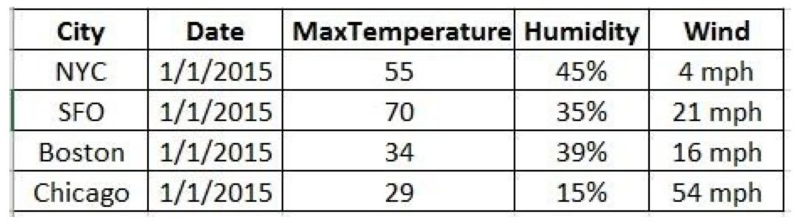
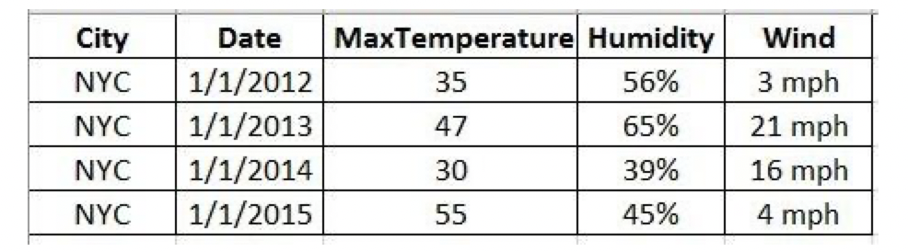
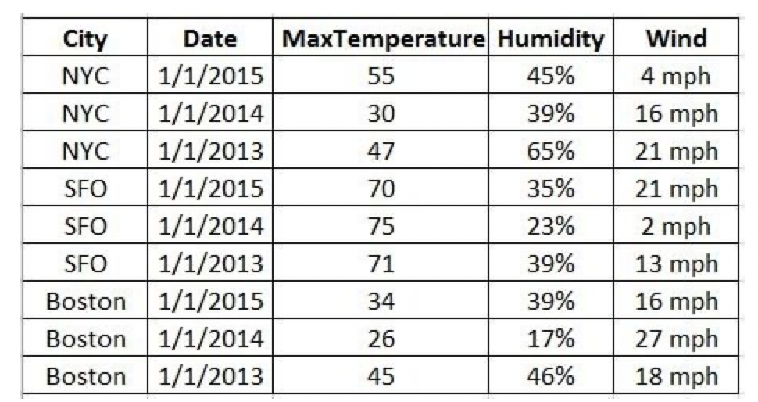
Time Series Basics
A
B
C

Slide 5
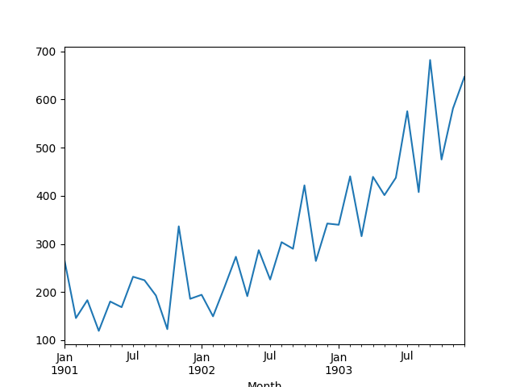
Time Series Basics
All the phenomenon whose behavior changes with time are called time series

Slide 6
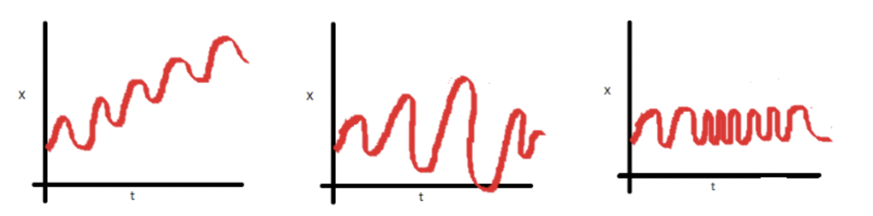
Time Series Basics
Stationary vs Non Stationary

Slide 7
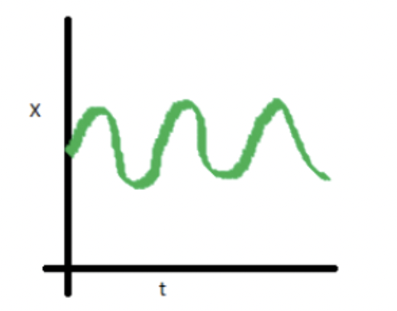
Time Series Basics
Stationary ?

Slide 8
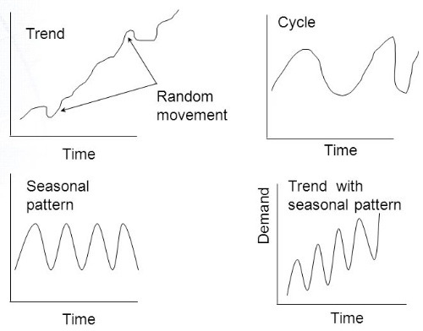
Time Series Basics

Slide 9
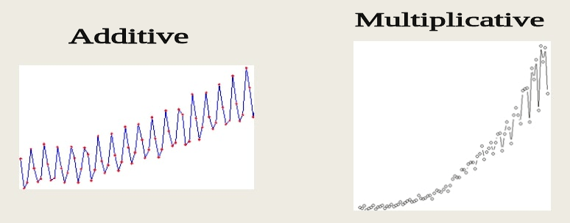
Time Series Basics

Slide 10
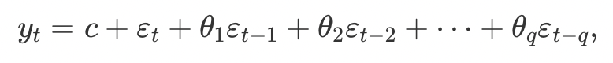
Time Series Basics (ARIMA)
AR
MA
ARMA

Slide 11
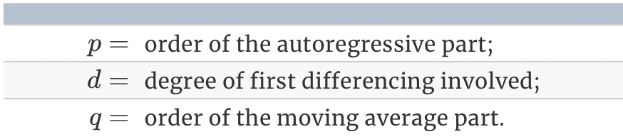
Time Series Basics (ARIMA)

Slide 12
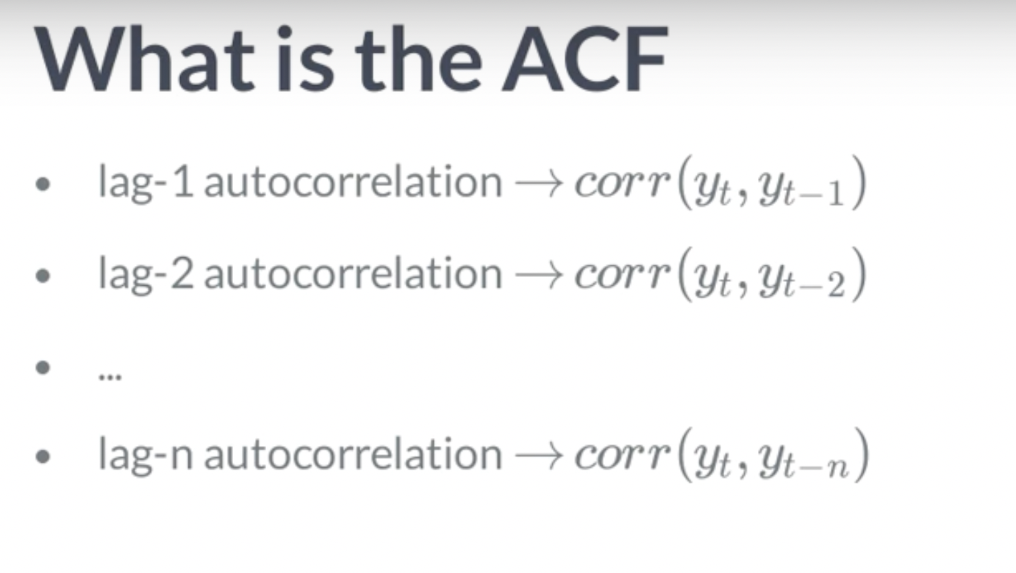
Time Series Basics (ARIMA)

Slide 13
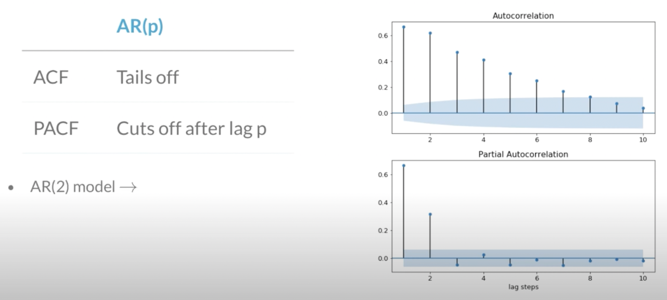
Time Series Basics

Slide 14
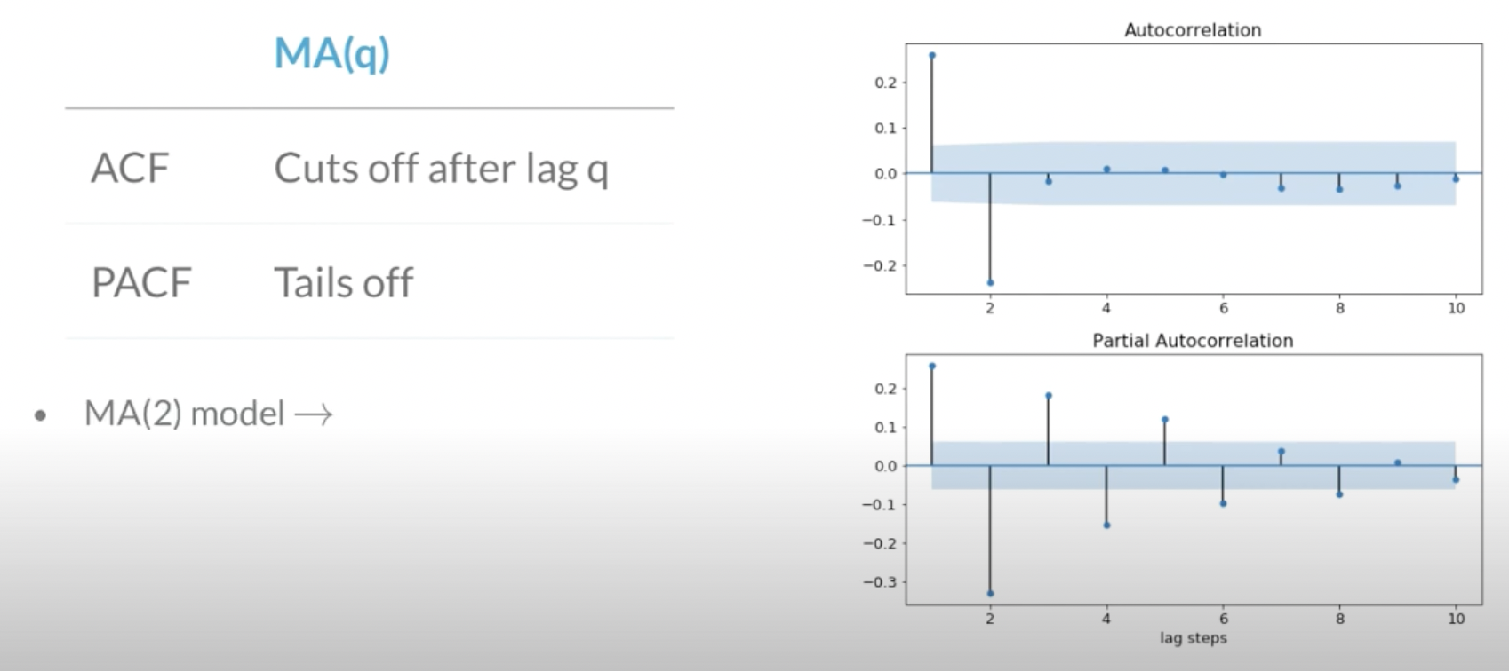
Time Series Basics

Slide 15
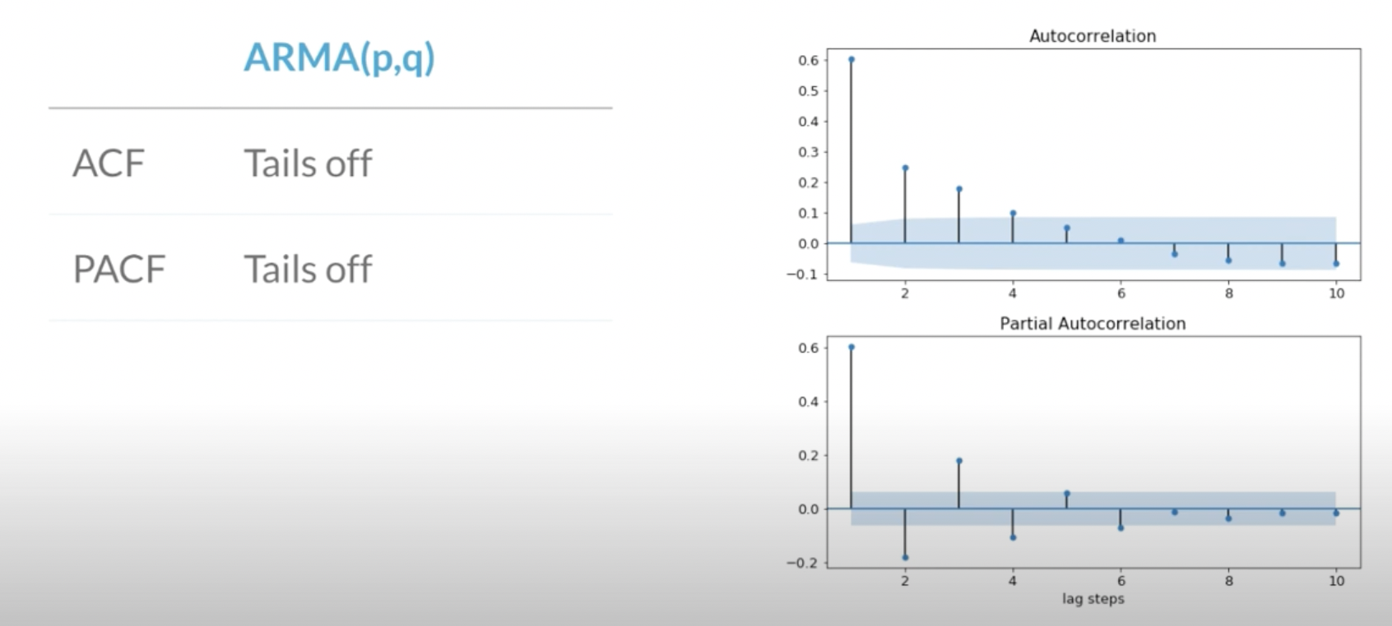
Time Series Basics

Slide 16
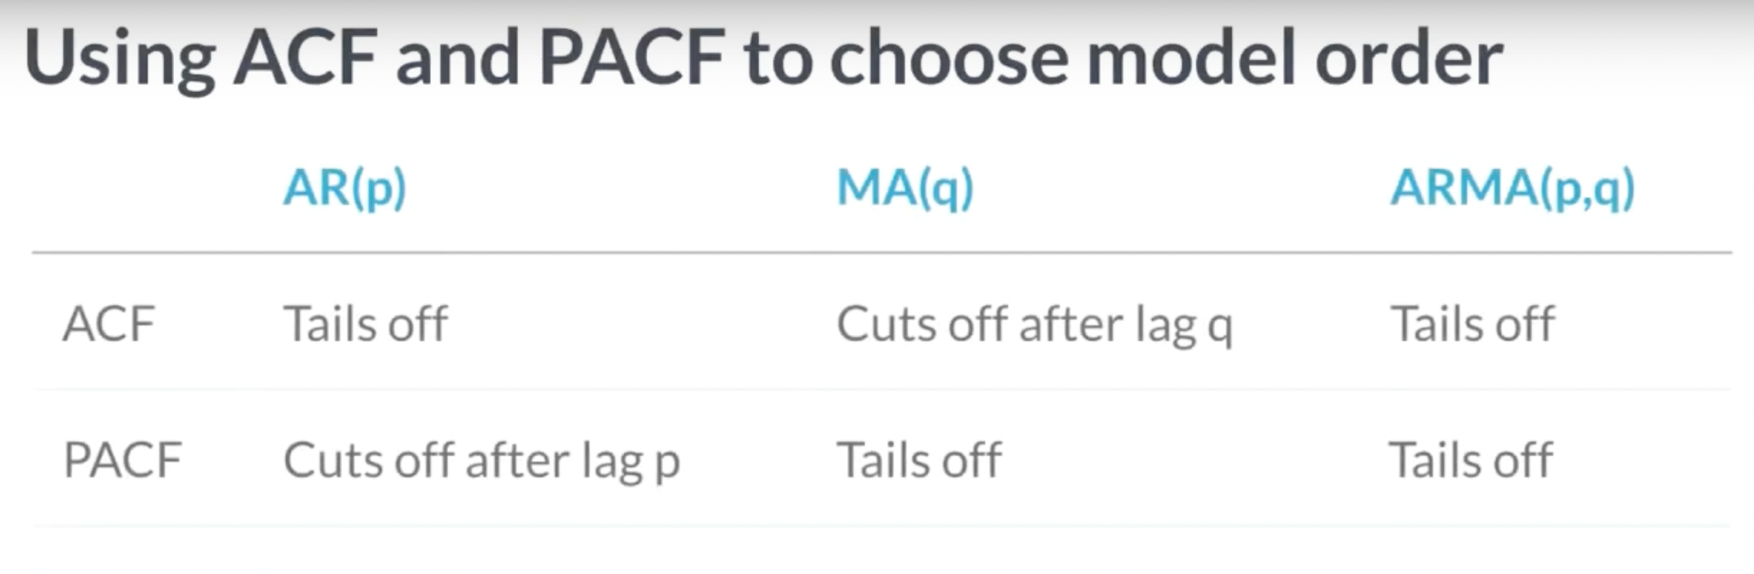
Time Series Basics

Slide 17
Python Basics
“Hello World”
Data type (Number, String, Tuple , List, Dictionary)
Conditional Statement ( If , Else , Elif )
Loop ( For, While )
Function
Modules
IDE ( Pycharm, Eclipse, Jupyter Notebook)
Python libraries ( Numpy, Pandas, Scipy, Matplotlib, Seaborn and Sklearn)

Slide 18
EDA & Modelling
Air Passenger dataset
Check Stationarity of TS (ADF test)
Make Series Stationary
Eliminating trend and seasonality
Forecasting (ARIMA)

Slide 19
Links & References
https://www.tutorialspoint.com/python/index.htm
https://www.kaggle.com/chirag19/time-series-analysis-with-python-beginner
https://www.kaggle.com/chirag19/air-passengers
DigitalOcean article on Time Series Forecasting.
DigitalOcean article on Time Series Forecasting.

